Slide 1


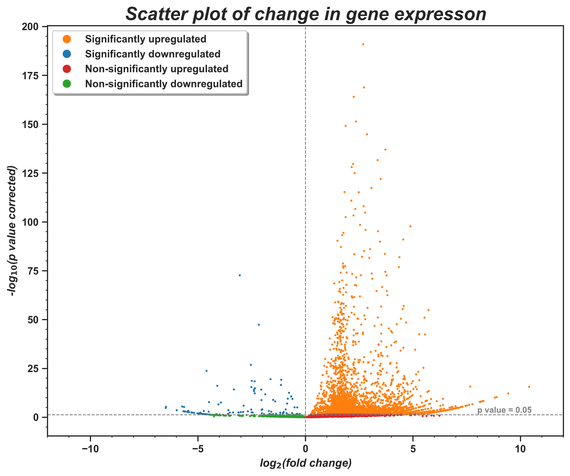


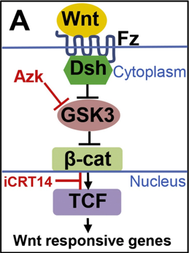
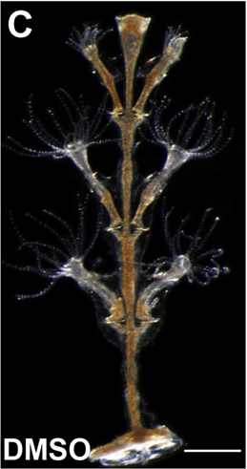
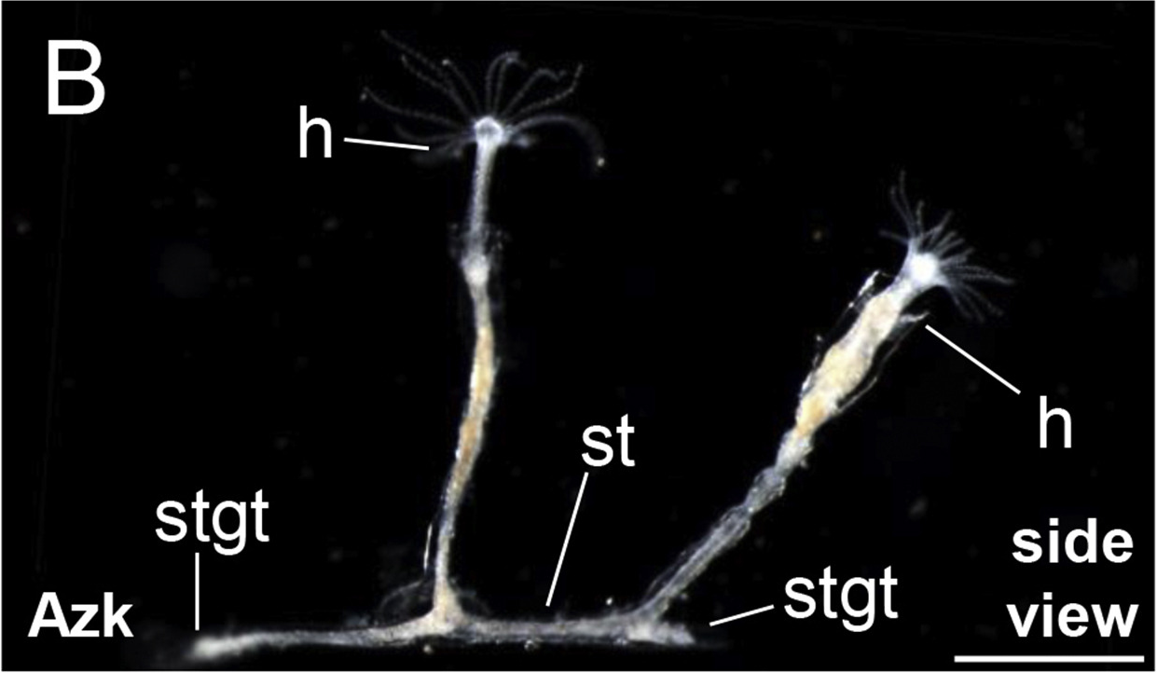
Screening of cWnt downstream targets involved in regulation of Dynamena pumilla body axis using differential expression analysis
Student:
Bredov Denis
Supervisor:
Stanislav Kremnyov, Department of Embryology, Lomonosov Moscow State University
Aim :
Identify the entire spectrum of genes that could potentially regulate the morphological polarization of Dynamena pumila embryo under cWnt signaling pathway.
Objectives:
Perform differential expression analysis on untreated and experimental groups.
Identify transcripts with significant changes in expression.
Identify 100 transcripts with most remarkable upregulation and 100 transcripts with most remarkable downregulation in expression.
Reveal changes in expression for set of specific canonical Wnt signaling pathway effectors.
Bagaeva et al., 2019

Slide 2
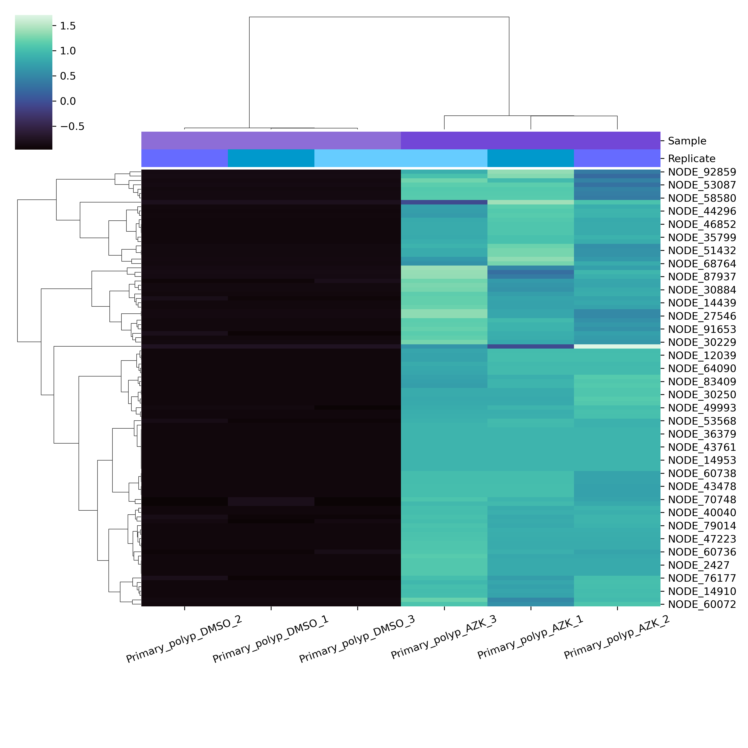
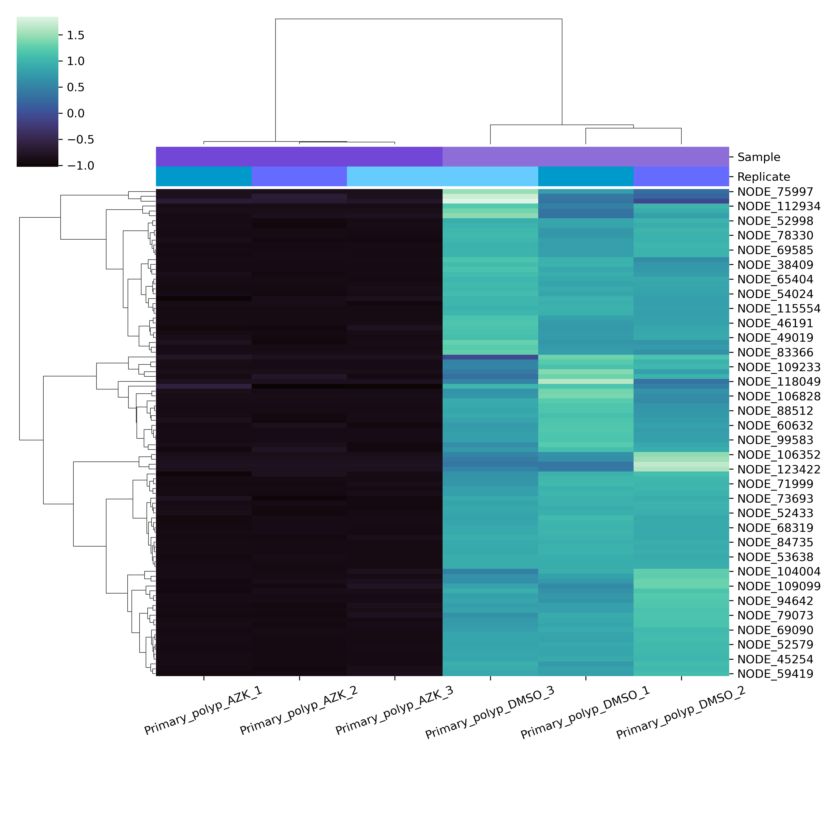
Supplementary figures
Cluster map of top-100 transcript with upregulation in expression
Cluster map of top-100 transcript with downregulation in expression

